Slide 1
CSE 12 Week 5 Discussion
11-3-20
Focus: Sorting

Slide 2
Reminders
PA5 is a closed assignment - no collaborating!
PA2 Resubmission due Thursday, November 5th 11:59 PM
PA3 Resubmission due Thursday, November 12th 11:59 PM

Slide 3
Sorting

Slide 4
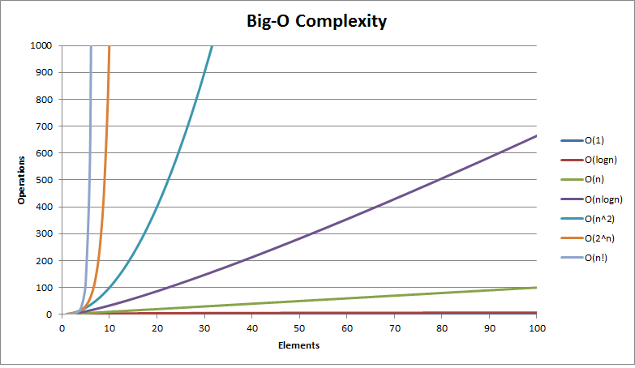
Big-O review
Relative to input n
Constants do not matter
O(3n)=O(n)
Higher order values dominate
O(n^2 + n) = O(n^2)

Slide 5
Algorithms review
Which algorithm finds the minimum element in a list and moves it to the end of a sorted prefix in the list?
Selection sort
Insertion sort
insert()
transform()

Slide 6
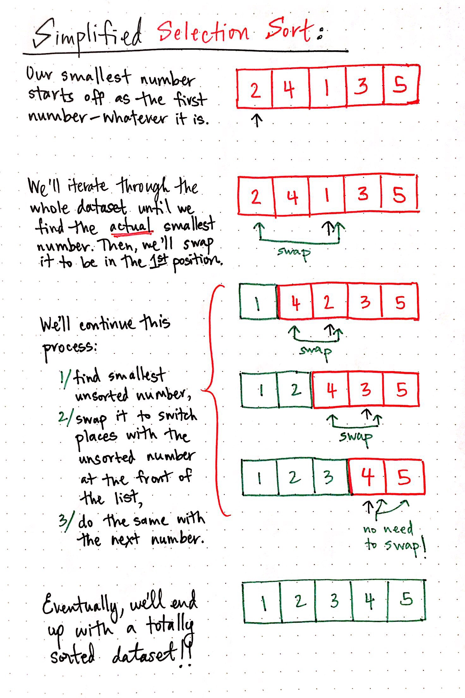
Answer - A
(selection sort)

Slide 7
Selection sort
public static void sSort(int[] arr) {
for(int i = 0; i < arr.length; i += 1) {
System.out.print(Arrays.toString(arr) + " -> ");
int minIndex = i;
for(int j = i; j < arr.length; j += 1) {
if(arr[minIndex] > arr[j]) { minIndex = j; }
}
int temp = arr[i];
arr[i] = arr[minIndex];
arr[minIndex] = temp;
System.out.println(Arrays.toString(arr));
}
}
What is the worst case runtime for selection sort?
O(n^2)
O(n)
O(nlogn)
o(n!)
None of the above

Slide 8
Answer - A
public static void sSort(int[] arr) {
for(int i = 0; i < arr.length; i += 1) {
System.out.print(Arrays.toString(arr) + " -> ");
int minIndex = i;
for(int j = i; j < arr.length; j += 1) {
if(arr[minIndex] > arr[j]) { minIndex = j; }
}
int temp = arr[i];
arr[i] = arr[minIndex];
arr[minIndex] = temp;
System.out.println(Arrays.toString(arr));
}
}
In worst case, outer loop is order of O(n) and inner loop is the order of O(n).
O(n) * O(n) = O(n^2)

Slide 9
Selection sort
public static void sSort(int[] arr) {
for(int i = 0; i < arr.length; i += 1) {
System.out.print(Arrays.toString(arr) + " -> ");
int minIndex = i;
for(int j = i; j < arr.length; j += 1) {
if(arr[minIndex] > arr[j]) { minIndex = j; }
}
int temp = arr[i];
arr[i] = arr[minIndex];
arr[minIndex] = temp;
System.out.println(Arrays.toString(arr));
}
}
What is the best case runtime for selection sort?
O(n^2)
O(n)
O(nlogn)
o(n!)
None of the above

Slide 10
Answer - A
public static void sSort(int[] arr) {
for(int i = 0; i < arr.length; i += 1) {
System.out.print(Arrays.toString(arr) + " -> ");
int minIndex = i;
for(int j = i; j < arr.length; j += 1) {
if(arr[minIndex] > arr[j]) { minIndex = j; }
}
int temp = arr[i];
arr[i] = arr[minIndex];
arr[minIndex] = temp;
System.out.println(Arrays.toString(arr));
}
}
Even in best case, outer loop runs through all iterations while going through entire inner loop each time
O(n) * O(n) = O(n^2)

Slide 11
Selection sort
public static void sSort(int[] arr) {
for(int i = 0; i < arr.length; i += 1) {
System.out.print(Arrays.toString(arr) + " -> ");
int minIndex = i;
for(int j = i; j < arr.length; j += 1) {
if(arr[minIndex] > arr[j]) { minIndex = j; }
}
int temp = arr[i];
arr[i] = arr[minIndex];
arr[minIndex] = temp;
System.out.println(Arrays.toString(arr));
}
}
How can we optimize selection sort?
Start inner loop at j=0 instead of j=i
Swap elements inside the inner loop
Make outer loop bound arr.length-1 instead of arr.length
Start outer loop at i=1 instead of i=0
Cannot be optimized any further for correct solution

Slide 12
Answer - C
public static void sSort(int[] arr) {
for(int i = 0; i < arr.length-1; i += 1) {
System.out.print(Arrays.toString(arr) + " -> ");
int minIndex = i;
for(int j = i; j < arr.length; j += 1) {
if(arr[minIndex] > arr[j]) { minIndex = j; }
}
int temp = arr[i];
arr[i] = arr[minIndex];
arr[minIndex] = temp;
System.out.println(Arrays.toString(arr));
}
}
Last element (arr[arr.length-1]) must already be in correct place, so cut down algorithm by 1 iteration
Cannot compare values with other indices because at end of list anyways

Slide 13
Selection sort
public static void sSort(int[] arr) {
for(int i = 0; i < arr.length-1; i += 1) {
System.out.print(Arrays.toString(arr) + " -> ");
int minIndex = i;
for(int j = i; j < arr.length; j += 1) {
if(arr[minIndex] > arr[j]) { minIndex = j; }
}
int temp = arr[i];
arr[i] = arr[minIndex];
arr[minIndex] = temp;
System.out.println(Arrays.toString(arr));
}
}
By changing outer loop bound to arr.length-1, what is the new worst case runtime of selection sort?
O(n^2)
O(n)
O(nlogn)
O(n!)
None of the above

Slide 14
Answer - A
public static void sSort(int[] arr) {
for(int i = 0; i < arr.length-1; i += 1) {
System.out.print(Arrays.toString(arr) + " -> ");
int minIndex = i;
for(int j = i; j < arr.length; j += 1) {
if(arr[minIndex] > arr[j]) { minIndex = j; }
}
int temp = arr[i];
arr[i] = arr[minIndex];
arr[minIndex] = temp;
System.out.println(Arrays.toString(arr));
}
}
No change in runtime (still O(n^2 for worst and best cases)
Reducing outer loop by 1 iteration results in O(n-1) for outer loop, which is same as O(n)
Inner loop still runs O(n)
O(n) * O(n) = O(n^2)

Slide 15
Algorithms Review
Which algorithm repeatedly takes the next element in a list inserts it into the correct ordered position within a sorted prefix of the list?
Selection sort
Insertion sort
insert()
transform()

Slide 16
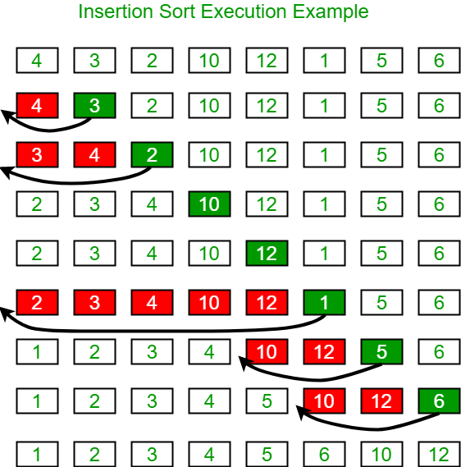
Answer - B (insertion sort)

Slide 17
Insertion sort
public static void iSort(int[] arr) {
for(int i = 0; i < arr.length; i += 1) {
System.out.print(Arrays.toString(arr) + " -> ");
for(int j = i; j > 0; j -= 1) {
if(arr[j] < arr[j-1]) {
int temp = arr[j-1];
arr[j-1] = arr[j];
arr[j] = temp;
}
}
System.out.println(Arrays.toString(arr));
}
}
What is the worst case runtime for insertion sort?
O(n^2)
O(n)
O(nlogn)
o(n!)
None of the above

Slide 18
Answer - A
public static void iSort(int[] arr) {
for(int i = 0; i < arr.length; i += 1) {
System.out.print(Arrays.toString(arr) + " -> ");
for(int j = i; j > 0; j -= 1) {
if(arr[j] < arr[j-1]) {
int temp = arr[j-1];
arr[j-1] = arr[j];
arr[j] = temp;
}
}
System.out.println(Arrays.toString(arr));
}
}
In worst case, outer loop is order of O(n) and inner loop is the order of O(n).
O(n) * O(n) = O(n^2)

Slide 19
Insertion sort
public static void iSort(int[] arr) {
for(int i = 0; i < arr.length; i += 1) {
System.out.print(Arrays.toString(arr) + " -> ");
for(int j = i; j > 0; j -= 1) {
if(arr[j] < arr[j-1]) {
int temp = arr[j-1];
arr[j-1] = arr[j];
arr[j] = temp;
}
}
System.out.println(Arrays.toString(arr));
}
}
What is the best case runtime for insertion sort?
O(n^2)
O(n)
O(nlogn)
o(n!)
None of the above

Slide 20
Answer - A
public static void iSort(int[] arr) {
for(int i = 0; i < arr.length; i += 1) {
System.out.print(Arrays.toString(arr) + " -> ");
for(int j = i; j > 0; j -= 1) {
if(arr[j] < arr[j-1]) {
int temp = arr[j-1];
arr[j-1] = arr[j];
arr[j] = temp;
}
}
System.out.println(Arrays.toString(arr));
}
}
Even in best case, outer loop runs through all iterations while going through entire inner loop each time
O(n) * O(n) = O(n^2)

Slide 21
Insertion sort
public static void iSort(int[] arr) {
for(int i = 0; i < arr.length; i += 1) {
System.out.print(Arrays.toString(arr) + " -> ");
for(int j = i; j > 0; j -= 1) {
if(arr[j] < arr[j-1]) {
int temp = arr[j-1];
arr[j-1] = arr[j];
arr[j] = temp;
}
}
System.out.println(Arrays.toString(arr));
}
}
How can we optimize insertion sort?
Compare arr[j] to arr[j-2] also
Break out of inner loop if arr[j] is >= arr[j-1]
Make outer loop bound arr.length-1 instead of arr.length
Break out of outer loop if arr[j] is >= arr[j-1]
Cannot be optimized any further for correct solution

Slide 22
Answer - B
public static void iSort(int[] arr) {
for(int i = 0; i < arr.length; i += 1) {
System.out.print(Arrays.toString(arr) + " -> ");
for(int j = i; j > 0; j -= 1) {
if(arr[j] < arr[j-1]) {
int temp = arr[j-1];
arr[j-1] = arr[j];
arr[j] = temp;
}
else {
break;
}
}
System.out.println(Arrays.toString(arr));
}
}
Once we see that elements are in the right order, we do not need to look at earlier elements since they will already be ordered

Slide 23
Insertion sort
public static void iSort(int[] arr) {
for(int i = 0; i < arr.length; i += 1) {
System.out.print(Arrays.toString(arr) + " -> ");
for(int j = i; j > 0; j -= 1) {
if(arr[j] < arr[j-1]) {
int temp = arr[j-1];
arr[j-1] = arr[j];
arr[j] = temp;
}
else {
break;
}
}
System.out.println(Arrays.toString(arr));
}
}
By adding the else statement with a break, what is the new worst case runtime of insertion sort?
O(n^2)
O(n)
O(nlogn)
O(n!)
None of the above

Slide 24
Answer - A
public static void iSort(int[] arr) {
for(int i = 0; i < arr.length; i += 1) {
System.out.print(Arrays.toString(arr) + " -> ");
for(int j = i; j > 0; j -= 1) {
if(arr[j] < arr[j-1]) {
int temp = arr[j-1];
arr[j-1] = arr[j];
arr[j] = temp;
}
else {
break;
}
}
System.out.println(Arrays.toString(arr));
}
}
No change in runtime (still O(n^2) for worst case)
Will not call break statement in worst case because entire list is out of order
Inner and outer loops each run O(n)
O(n) * O(n) = O(n^2)

Slide 25
Insertion sort
public static void iSort(int[] arr) {
for(int i = 0; i < arr.length; i += 1) {
System.out.print(Arrays.toString(arr) + " -> ");
for(int j = i; j > 0; j -= 1) {
if(arr[j] < arr[j-1]) {
int temp = arr[j-1];
arr[j-1] = arr[j];
arr[j] = temp;
}
else {
break;
}
}
System.out.println(Arrays.toString(arr));
}
}
By adding the else statement with a break, what is the new best case runtime of insertion sort?
O(n^2)
O(n)
O(nlogn)
O(n!)
None of the above

Slide 26
Answer - B
public static void iSort(int[] arr) {
for(int i = 0; i < arr.length; i += 1) {
System.out.print(Arrays.toString(arr) + " -> ");
for(int j = i; j > 0; j -= 1) {
if(arr[j] < arr[j-1]) {
int temp = arr[j-1];
arr[j-1] = arr[j];
arr[j] = temp;
}
else {
break;
}
}
System.out.println(Arrays.toString(arr));
}
}
Best case: sorted list
As a result, will call break statement each time inner loop is entered
Inner loop runs O(1)
Outer loop still runs O(n)
O(n) * O(1) = O(n)

Slide 27

Sorting Algorithm Visualizations
https://www.youtube.com/watch?v=kPRA0W1kECg
If you do not have a hearing sensitivity, we recommend having the volume on during these visualizations. Lower pitches correspond to operations on smaller bars/values, and higher pitches correspond to operations on larger bars/values. Check out the top left corner for the current sort method and number of certain operations.
The first 4 sort methods are the 4 you’ve learned so far: insertion, selection, quick, and merge sort.
Note on bogo sort: this is a bit of a joke in CS. Bogo sort works by randomly moving all of the values until it finds the sorted solution by chance; it is the last sort method in the video. It has run time upper bound: O((n+1)!)

